Slide 1


Welcome to notpron, AP Music Theory Edition!
As former AP Music Theory students, and current CS and Interactive Media and Design Majors, respectively, we have both the means and the motive to make this. Enjoy!
Click here

Slide 2
WARNING: For the playability of this game, please do not use arrow keys to navigate between slides
Click here

Slide 3
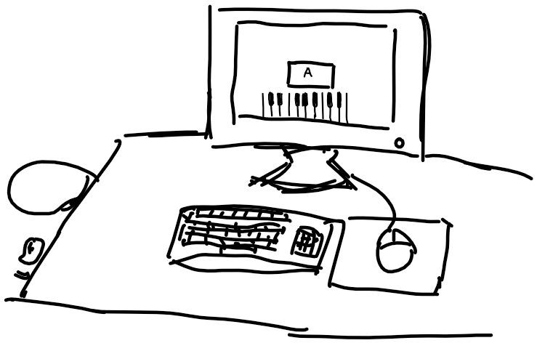
Level 1: Let’s start with something simple…

Slide 4
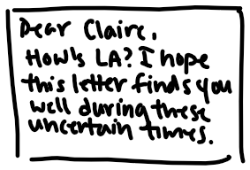
Level 1: Let’s start with something simple…

Slide 5
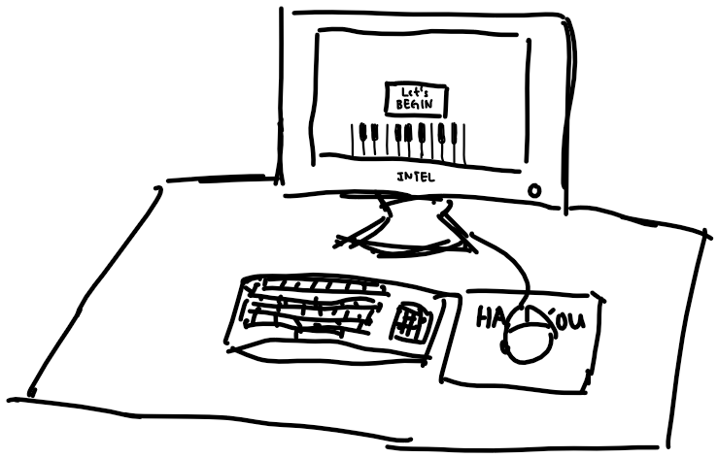
Level 2: The real beginning

Slide 6
Level 2: The real beginning
Level 2: The real beginning
Sometimes, You Have to Think Outside the Box

Slide 7
Level 2: The real beginning

Slide 8
Level 2: The real beginning

Slide 9
Level 2: The real beginning

Slide 10
It’s Rewind Time…

Slide 11
Level 2: The real beginning

Slide 12
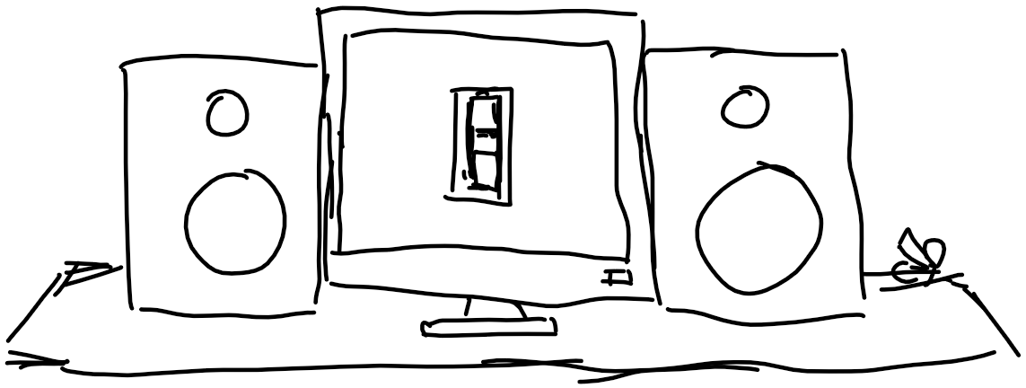
Level 3: Build up Our Machine

Slide 13
Level 3: Build up Our Machine

Slide 14









Level 3: Build up Our Machine

Slide 15
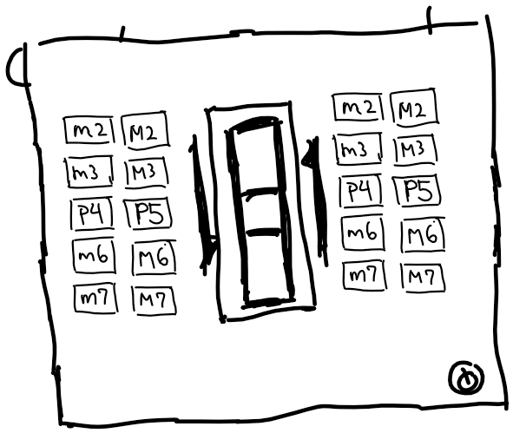
Level 3: Build up Our Machine

Slide 16

Level 3: Build up Our Machine

Slide 17
Level 3: Build up Our Machine

Slide 18
Level 3: Build up Our Machine

Slide 19
Level 3: Build up Our Machine

Slide 20

Level 3: Build up Our Machine

Slide 21
Level 3: Build up Our Machine

Slide 22
Level 3: Build up Our Machine

Slide 23
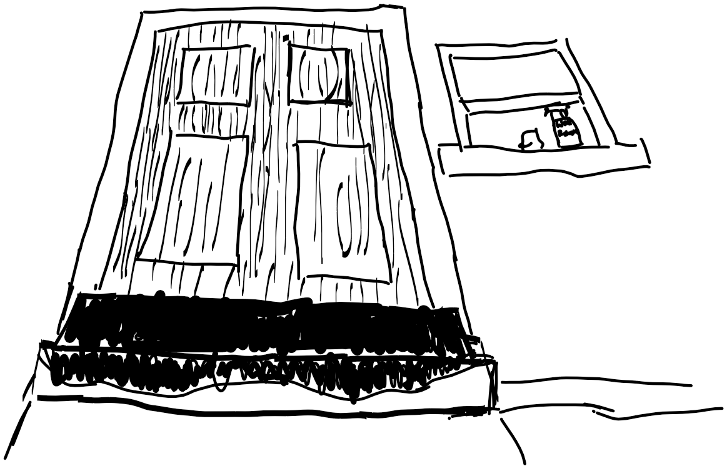
Level 4: Mimi’s Secret Knock

Slide 24
Level 4: Mimi’s Secret Knock
There seems to be something
Coating the stairs

Slide 25

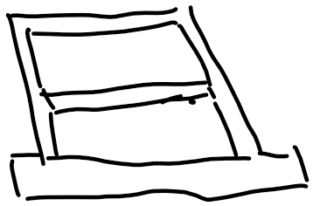


Level 4: Mimi’s Secret Knock
CLEAN

Slide 26




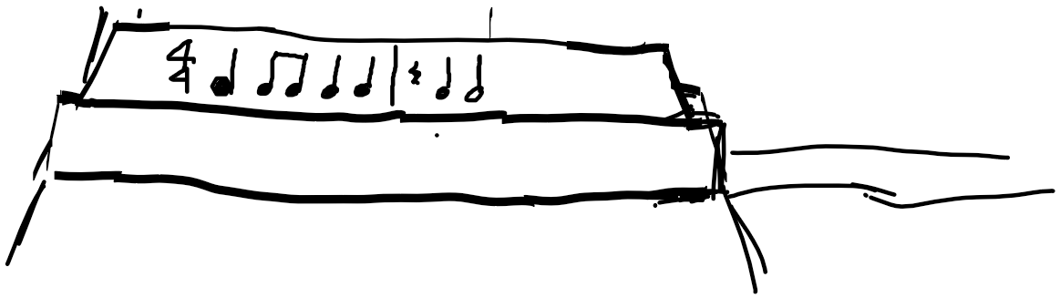

Level 4: Mimi’s Secret Knock

Slide 27

Level 4: Mimi’s Secret Knock

Slide 28
Level 4: Mimi’s Secret Knock

Slide 29
Level 4: Mimi’s Secret Knock

Slide 30
Level 4: Mimi’s Secret Knock

Slide 31
Level 4: Mimi’s Secret Knock

Slide 32
Level 4: Mimi’s Secret Knock

Slide 33
Level 4: Mimi’s Secret Knock

Slide 34
Level 4: Mimi’s Secret Knock

Slide 35
Level 4: Mimi’s Secret Knock

Slide 36
Level 5: In construction
More Levels coming Soon!

